Slide 1
Brazil Update
44th IPHE Steering Committee Meeting
24 – 25 November 2025
Riyadh, Kingdom of Saudi Arabia

Slide 2
Announcements / New Initiatives - Brazil
Initiatives and Investments
ANP Publishes Authorization Manual for Low-Emissions Hydrogen
The document consolidates the necessary paperwork, procedures, and interactions with the Agency. Therefore, a practical guide for permitting the production, operation, import/loading, and commercialization until the final resolutions are issued.
ANP performs the Brazil H2 Risk Management Webinar
This webinar presented an overview of the advancements of Brazil’s legal and regulatory framework for low-carbon hydrogen. The focus was on risk management requirements for hydrogen production facilities.
Brazilian Government Launches Public Call of BRL 60 Million to Establish a Low-Carbon Hydrogen Research Center
The public call to select a research network composed of universities and technology institutes across Brazil. The selected institutions will receive funding to establish laboratories, hire researchers, train specialized professionals, and undertake joint projects with private companies.
44th IPHE Steering Committee - 24-25 November 2025

Slide 3
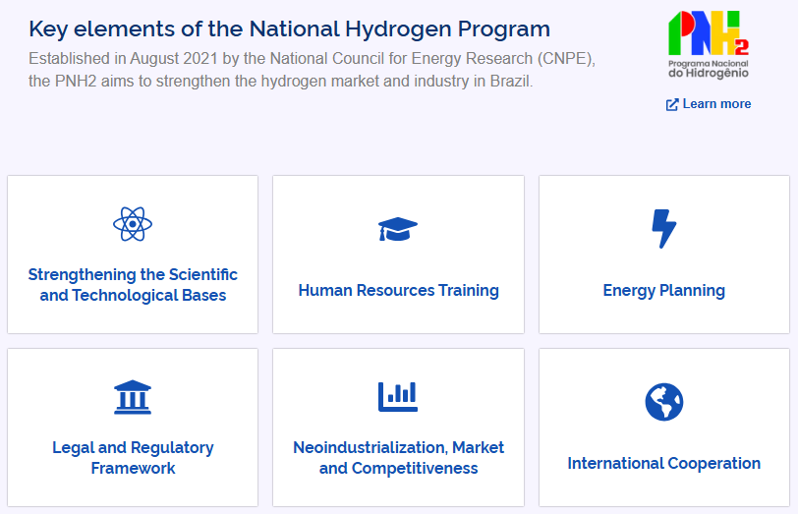
Announcements / New Initiatives - Brazil
Initiatives
MME and EPE Launch the Brazilian Hydrogen Portal
The platform connects initiatives ranging from scientific and technological capacity building to energy planning, while also promoting improvements in the legal and regulatory framework, fostering reindustrialization, market development, and competitiveness in Brazil’s emerging hydrogen economy.
44th IPHE Steering Committee - 24-25 November 2025

Slide 4
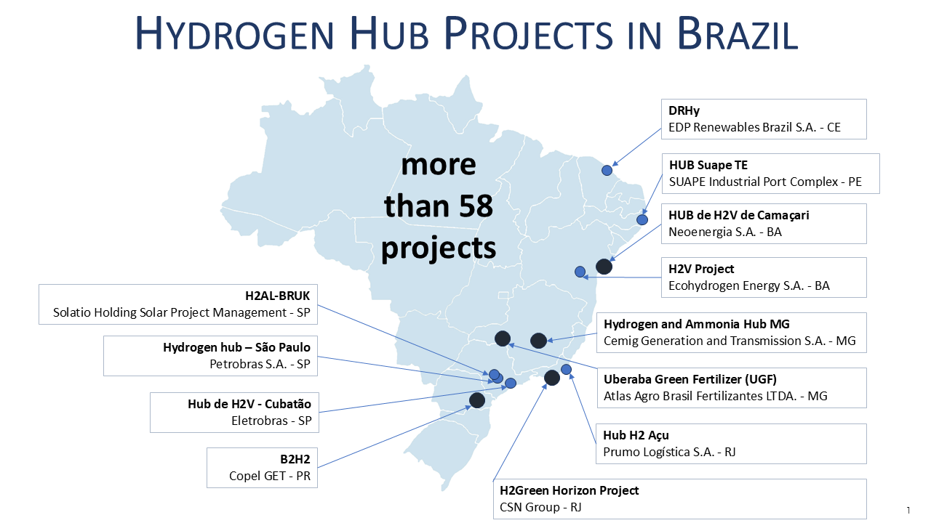
Announcements / New Initiatives - Brazil
Initiatives
Results of the H₂ Hubs Call for Industrial Decarbonization
This initiative represents a significant step toward identifying national projects that can contribute to the energy transition and the decarbonization of hard-to-abate industrial sectors.
44th IPHE Steering Committee - 24-25 November 2025

Slide 5
Announcements / New Initiatives - Brazil
Investments
ANEEL Approves R&D Projects Focused on Hydrogen Applications
The initiatives were presented under Call 23/2024 – Hydrogen in the Context of the Brazilian Electric Sector, announced in October 2025, with total R&D investments of nearly BRL 1.2 billion (USD 204 million).
Eletrobras – Pilot Plant for Renewable Hydrogen Production for Industrial Applications
Eneva – Pilot Plant for Renewable Hydrogen Production to Promote Energy Transition and Industrial Decarbonization in the Food Sector
Petrobras – Low-Carbon Hydrogen Production via Water Electrolysis Integrated into a Petroleum Refinery
CTG Brasil – Development of an H₂ Plant and Traceability & Certification Methodology Applied to the Pulp and Paper Industry
CTG Brasil – Pilot Project for Green Hydrogen Production in a Merchant Model
44th IPHE Steering Committee - 24-25 November 2025

Slide 6
Announcements / New Initiatives - Brazil
New Research & Development, Demonstration and/or Deployment Activities
UFPR Inaugurates Pilot Plant Producing Renewable Hydrogen from Food Waste Without Using Water
This pioneering project in Brazil collects organic waste generated by the university’s dining hall to produce high-purity renewable hydrogen without using water. The process is based on biogas obtained from the anaerobic digestion of organic waste, followed by dry catalytic reforming of the biogas to generate hydrogen.
EPE Releases Technical Note on Hydrogen and Biomass: Opportunities for Brazil
This Technical Note explores the synergistic relationship between low-carbon hydrogen and bioenergy, highlighting opportunities for mutual strengthening of both sectors and their potential contribution to Brazil’s energy transition.
44th IPHE Steering Committee - 24-25 November 2025

Slide 7
Examples of Lessons Learned and Impact - Brazil
Program initiative, policy, regulation or mandate | Lessons Learned/Outcomes
Law 14.948/2024 | Guarantee of technological neutrality
 | Permission to mix hydrogen with different emission intensities
 | Contemplating natural hydrogen
Public call for low-emission hydrogen hubs from the Ministry of Mines and Energy (MME) | Received 70 responses from various regions of Brazil, indicating optimism on the supply side
44th IPHE Steering Committee - 24-25 November 2025

Slide 8
Brazil – Profile November 2025
Status of Deployments
Leading Government Initiatives
Goals or Focus Areas
There is still a lot of work and coordination needed between the Government and Regulatory Agencies.
Decree in final phase: Regulation of the low-carbon hydrogen industry and other mechanisms, such as the SBCE.
The 5 projects selected by Ministry of Mines and Energy, under Brazil’s Investment Plan (part of the Climate Investment Funds – CIF-ID)
Publication of the Regulatory Decree of Laws 14.948/2024 and 14.990/2024.
Publication of the Regulatory Decree of Brazilian Greenhouse Gas Emissions Trading System (SBCE): Law 15.042/2024.
Development of Hydrogen Hubs.
Scientific and Technology Bases
Human Resources Training
Energy Planning
Legal and Regulatory-Normative Framework
Neo-industrialization, Market and Competitiveness
Deployment Goals
Funding
Ministry of Mines and Energy (MME), with the objective of consolidating integrated hubs for the production, storage, transportation and consumption of low-carbon hydrogen in Brazil by 2035.
ANEEL (USD 204 million), MME (USD 250 million), EMBRAPII (USD 11 million)

Slide 9
Thank you

